Slide 1



WEEK 3 POWER BI
View in Power BI
Last data refresh:
11/18/2022 5:59:17 PM UTC
Downloaded at:
1/24/2023 8:23:52 PM UTC

Slide 2
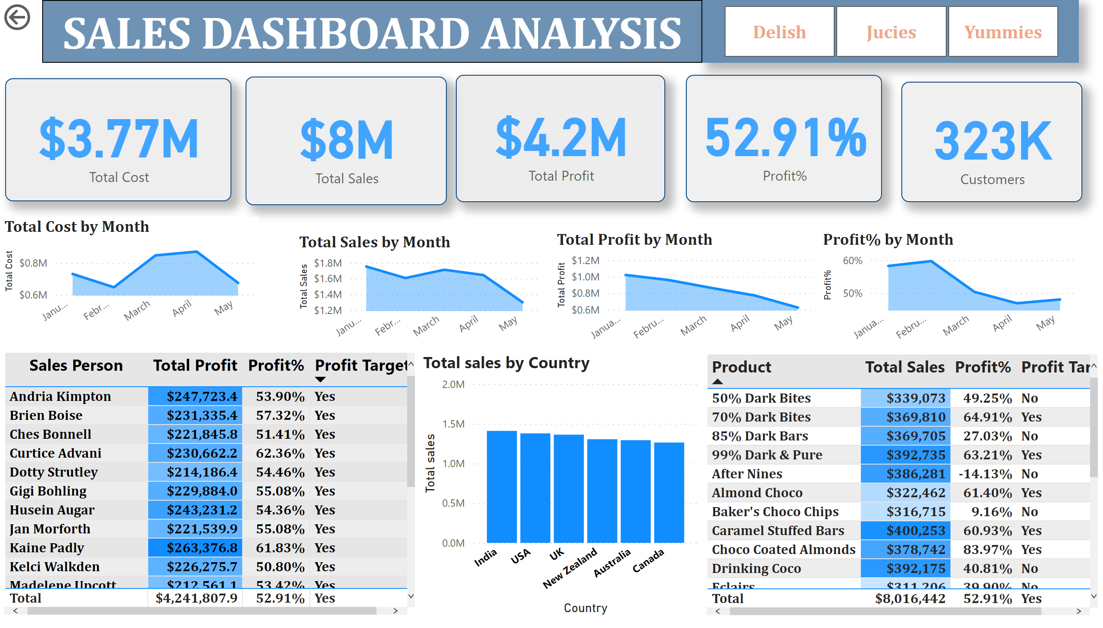
Card plot
Notes:
slicer
No alt text provided
textbox
No alt text provided
card
No alt text provided
columnChart
No alt text provided
tableEx
No alt text provided
tableEx
No alt text provided
actionButton
No alt text provided
areaChart
No alt text provided
areaChart
No alt text provided
areaChart
No alt text provided
areaChart
No alt text provided
card
No alt text provided
card
No alt text provided
card
No alt text provided
card
No alt text provided

